Slide 1
Marketing Management

Slide 2
Defining Marketing
Marketing starts with customers and ends with customers.
The American Marketing Association defines marketing as:
“Marketing is an organisational function and a set of processes for creating, communicating, and delivering value to customers and for managing customer relationships in ways that benefit the organisation and its stakeholders.”
Marketing management is the art and science of choosing target markets and getting, keeping, and growing customers through creating, delivering, and communicating superior customer value.

Slide 3
Marketing?
Marketing is an organizational function and a set of processes for creating, communicating and delivering value to customers and for managing customer relationships in ways that benefit the organization and stakeholders
Marketing is identifying and meeting human and social needs.
Marketing is “meeting needs profitably”

Slide 4
What is marketing?
Delivering Value For a firm to deliver value to its customers, they must consider what is known as the "total market offering." This includes the reputation of the organization, staff representation, product benefits, and technological characteristics as compared to competitors' market offerings and prices. Value can thus be defined as the relationship of a firm's market offerings to those of its competitors
Customer Relationship The practice of building and maintaining ongoing friendships with customers in an effort to make them feel comfortable with an organization and its service providers and to enhance customer loyalty.
Marketing is the process of communicating the value of a product or service to customers, for the purpose of selling that product or service.

Slide 5
The Concept of Exchange
The concept of exchange is the essence and central to marketing thinking. Unless there is actual or potential exchange, there is no marketing.
Something of Value
(Goods, Service, Ideas, etc.)
Both Parties Freely Agree to the
Terms and
Conditions of Exchange
(Money, Credit, Goods, Labour)
Something of ValueMarketer
Marketer
Customer

Slide 6
For an exchange to occur…..
There are at least two parties.
Each party has something that might be of value to the other party.
Each party is capable of communication and delivery.
Each party is free to reject the exchange offer.
Each party believes it is appropriate or desirable to deal with the other party.

Slide 7
What is Marketed?
Goods
Services
Events
Experiences
Persons
Places
Properties
Organizations
Information
Ideas

Slide 8
Who markets?
Marketers and Prospects- A marketer is someone who seeks a response-attention, a purchase, a vote, a donation-from another party, called the prospect. If two parties are seeking to sell something to each other, we call them both marketers.

Slide 9
Marketing Tasks
1. Negative Demand: This situation is faced when a major part of the target market dislikes the product and may even pay a price to avoid it. The marketing task is to unearth and analyse the reasons for this state, and to learn if a product redesign or change in marketing mix elements can help.
2. No Demand: The customers may be unaware or indifferent towards the product. The remedy is to create product awareness and connect product benefits to customers’ needs and wants.
3. Dormant Demand: This may occur when the currently available products fail to satisfy the strong needs that customers feel. To meet the latent demand more effectively, the marketing task is to develop product or service if the market size is favourable.
Cont…

Slide 10
Marketing Tasks
4. Falling Demand: Sooner or later, companies face this situation with respect to their products or services. The task is to reverse this trend, and marketing should find out the reasons and take swift remedial action. New markets, product feature modification, or more focused and effective promotion may hold the solution.
5. Fluctuating Demand: Many companies experience this pattern, the demand varying according to the season, or festivals, etc. The task is to synchronise marketing efforts to alter the demand pattern by adopting flexible pricing, and sales promotion techniques.
6. Full Demand: This is a situation all companies aspire and work for. The task is to maintain the level of demand and keep pace with the changing customer preferences and ever increasing competition and monitor customer satisfaction.
Cont…

Slide 11
Marketing Tasks
7. Excess Demand: At this demand level, the company is unable to meet the demand level. The only option usually available is to find ways to decrease demand temporarily or permanently. Generally, marketing seeks to discourage overall demand through demarketing, either by increasing prices or reducing promotion and services. Selective demarketing involves reducing demand from those markets that are less profitable.
8. Unwholesome Demand: This concerns managing demand for harmful products. The marketing task is to make the public aware about the dangers and harmful effects caused through misuse or over use of such products by using appropriate degree of fear appeals, price hike, or reduced availability.

Slide 12
Possible Eight Demand States
Negative
Nonexistent
Latent
Declining
Irregular
Unwholesome
Full
Overfull

Slide 13
Possible Eight Demand States
Irregular Demand
Consumers purchases vary on a seasonal, monthly, weekly, daily or hourly e.g. Museums on week days, Travelling Peak Off Peak time
Unwholesome Demand
Consumers attracted to products that have undesirable social consequences e.g. Cigarettes, Alcohol, Drugs
Full Demand
Consumers are adequately buying all products.
Overfull Demand
More consumers would like to buy than can be satisfied.
Negative Demand
Consumers dislike the product e.g. Vaccination, Dental work
Nonexistent Demand
Consumers may be unaware of the product e.g. Foreign Language course
Latent Demand
Consumers may share a strong need that can’t be satisfied with existing product e.g. Harm less cigarettes, Fuel Efficient cars
Declining Demand
Consumers begins to buy the product less frequently e.g. churches, Govt. Schools

Slide 14
Markets
Traditionally, a “market” was a physical place where buyers and sellers gathered to buy and sell goods. Economists describe a market as a collection of buyers and sellers who transact over a particular product or product class.
Marketers often use the term market to cover various groupings of customers. They view sellers as constituting the industry and buyers as constituting the market.

Slide 15
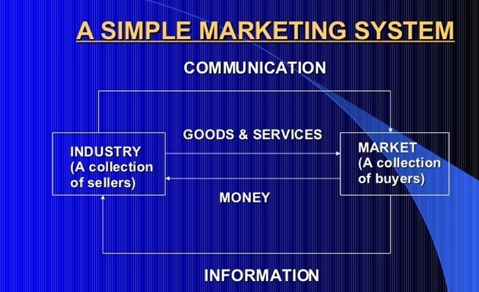

Slide 16
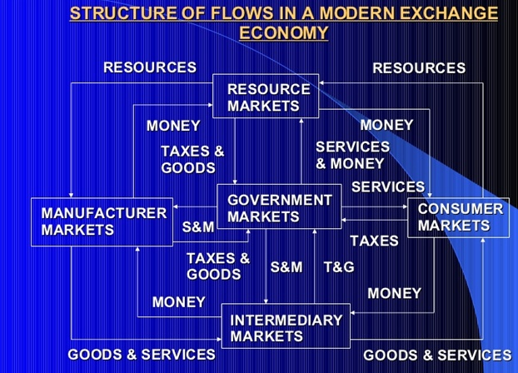

Slide 17
Key Customer Markets
Consumer markets
Business markets
Global markets
Nonprofit/Governmental markets

Slide 18
The marketplace isn’t what it used to be….
Changing technology
Globalization
Deregulation
Privatization
Empowerment
Customization
Convergence
Disintermediation

Slide 19
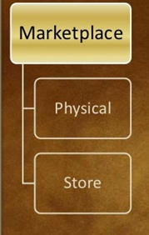
Marketplaces, Marketspaces and Metamarkets
Marketplace is physical such as a store you shop in

Slide 20
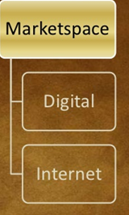
Marketplaces, Marketspaces and Metamarkets
Marketspace is digital, as when you shop on the Internet.

Slide 21
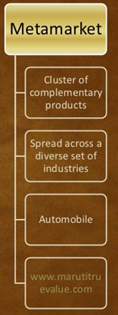
Marketplaces, Marketspaces and Metamarkets
A cluster of complementary products and services that are closely related in the mind of consumers but spread across a diverse set of industries.

Slide 22
Core Marketing Concepts
Needs, wants, and demands
Target markets, positioning, segmentation
Offerings and brands- Companies address needs by putting forth a value proposition a set of benefits that they offer to customers to satisfy their needs. The intangible value proposition is made physical by an offering which can be combination of products information and experiences.
Value and satisfaction Value reflects the sum of the perceived tangible and intangible benefits and costs to customers. It is a combination of quality service and price.(“qsp”) called “customer value triad”

Slide 23
Core Marketing Concepts
Marketing channels
Communication Channels e.g. Newspapers, Magazines Radio., Television, Mail, Telephone, Billboards, Posters, Fliers, CDs, Audio Tapes & Internet
Distribution Channels e.g. Distributors, Wholesalers, Retailers, & Agents
Supply chain is a longer channel stretching from raw materials to components to final products that are carried to final buyers.
Competition
Marketing environment
Task Environment e.g. Company, Suppliers, Distributors, Dealers & Target Customers
Broad Environment

Slide 24
The New Marketing Realities
Major societal Forces
Network information Technology
Globalization
Deregulation
Privatization
Heightened Competition
Industry Convergence
Consumer resistance
Retail Transformation
Disintermediation
Consumer buying power
Consumer information
Consumer participation
Consumer resistance

Slide 25
The New Marketing Realities
New Consumer Capabilities
A substantial increase in Buying Power
A greater variety of available goods and services
A great amount of information about practically any thing
Greater ease in interacting and placing and receiving orders
An ability to compare notes on product and services
An amplified voice to influence peer and public opinion

Slide 26
The New Marketing Realities
New Company Capabilities:
Marketers can use Internet as a powerful info and sales channel
Marketers can collect full and richer info about markets, customers, prospects and competitors
Can tap social media to amplify brand image
Can use mobile mktg
Can speed up both internal and external communication
Can send coupons, samples to facilitate sales
Can customized product offerings

Slide 27
Needs, Wants, and Demand
A need can be defined as a felt state of deprivation of some basic satisfaction.
The specific satisfier that an individual looks for defines the want.
When the want is backed by purchasing power, it is called the demand.

Slide 28
Needs
Stated Needs(The customer wants an inexpensive car)
Real Needs(The customer wants a car whose operating cost not its initial price is low)
Unstated needs(The customer expects good service from the dealer)
Delight Needs(customer would like the dealer to include an onboard navigation system)
Secret Needs(The customer want friends to see him as a savvy consumer)

Slide 29
Orientation, Marketing Orientation, Consumer Orientation
Orientation- the type of interests, activities, or aims that an organization, business, or project has, or the act of giving attention to a particular thing:
Marketing Orientation - is an organizational orientation that believes success is most effectively achieved by satisfying consumer demands.
Consumer Orientation - A service offered by companies that focuses on the internal and external needs of a business's customers. Consumer orientation establishes and monitors standards of customer satisfaction and strives to meet the clientele's needs and expectations related to the product or service sold by the business.

Slide 30
Evolution of Marketing Concept
The Production Concept
The product concept
The Selling Concept
The Marketing Concept

Slide 31
The Production Concept
Those companies who believe in this philosophy think that if the goods/services are cheap and they can be made available at many places, there cannot be any problem regarding sale.
Keeping in mind the same philosophy these companies put in all their marketing efforts in reducing the cost of production and strengthening their distribution system. In order to reduce the cost of production and to bring it down to the minimum level, these companies indulge in large scale production.
This helps them in effecting the economics of the large scale production. Consequently, the cost of production per unit is reduced.
The utility of this philosophy is apparent only when demand exceeds supply. Its greatest drawback is that it is not always necessary that the customer every time purchases the cheap and easily available goods or services

Slide 32
The Product Concept
Those companies who believe in this philosophy are of the opinion that if the quality of goods or services is of good standard, the customers can be easily attracted. The basis of this thinking is that the customers get attracted towards the products of good quality. On the basis of this philosophy or idea these companies direct their marketing efforts to increasing the quality of their product.
It is a firm belief of the followers of the product concept that the customers get attracted to the products of good quality. This is not the absolute truth because it is not the only basis of buying goods.
The customers do take care of the price of the products, its availability, etc. A good quality product and high price can upset the budget of a customer. Therefore, it can be said that only the quality of the product is not the only way to the success of marketing.

Slide 33
The Selling Concept
Those companies who believe in this concept think that leaving alone the customers will not help. Instead there is a need to attract the customers towards them. They think that goods are not bought but they have to be sold.
The basis of this thinking is that the customers can be attracted. Keeping in view this concept these companies concentrate their marketing efforts towards educating and attracting the customers. In such a case their main thinking is ‘selling what you have’.
This concept offers the idea that by repeated efforts one can sell-anything to the customers. This may be right for some time, but you cannot do it for a long-time. If you succeed in enticing the customer once, he cannot be won over every time.
On the contrary, he will work for damaging your reputation. Therefore, it can be asserted that this philosophy offers only a short-term advantage and is not for long-term gains.

Slide 34
The Marketing Concept
Those companies who believe in this concept are of the opinion that success can be achieved only through consumer satisfaction. The basis of this thinking is that only those goods/service should be made available which the consumers want or desire and not the things which you can do.
In other words, they do not sell what they can make but they make what they can sell. Keeping in mind this idea, these companies direct their marketing efforts to achieve consumer satisfaction.
In short, it can be said that it is a modern concept and by adopting it profit can be earned on a long-term basis. The drawback of this concept is that no attention is paid to social welfare.

Slide 35
Societal Marketing Concept
This concept stresses not only the customer satisfaction but also gives importance to Consumer Welfare/Societal Welfare. This concept is almost a step further than the marketing concept. Under this concept, it is believed that mere satisfaction of the consumers would not help and the welfare of the whole society has to be kept in mind.
For example, if a company produces a vehicle which consumes less petrol but spreads pollution, it will result in only consumer satisfaction and not the social welfare.
Primarily two elements are included under social welfare-high-level of human life and pollution free atmosphere. Therefore, the companies believing in this concept direct all their marketing efforts towards the achievement of consumer satisfaction and social welfare.
In short, it can be said that this is the latest concept of marketing. The companies adopting this concept can achieve long-term profit

Slide 36
Holistic Marketing Concept

Slide 37
Marketing Mix
In order to cater to the requirements of identified market segment, an entrepreneur has to develop an appropriate marketing mix. Marketing mix is a systematic and balanced combination of the four inputs which constitute the core of a company’s marketing system – the product, the price structure, the promotional activities and the place or distribution system”. These are popularly known as “Four P’s” of marketing. An appropriate combination of these four variables will help to influence demand. The problem facing small firms is that they sometimes do not feel themselves capable of controlling each of the four variables in order to influence the demand.

Slide 38
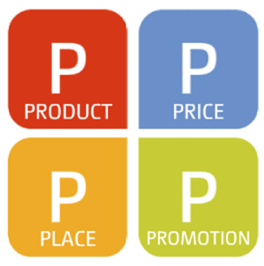
Marketing Mix: Four Ps
The offer you make to your customer can be altered by varying the mix elements.
So for a high profile brand, increase the focus on promotion and desensitize the weight given to price.

Slide 39
Marketing Mix
4 Ps: Product, Price, Place (distribution) and Promotion
Product Price Place Promotion Decisions Decisions Decisions Decisions
Brand name Pricing strategy Distribution
Functionality Suggested retail channels (push, pull, etc.)
price
Styling Wholesale price Market coverage Advertising
Quality Various discounts - intensive Sales promotion
Safety Seasonal pricing - selective Personal selling
Packaging Bundling - exclusive PR / publicity
Repairs & support Price flexibility Inventory Promotional budget
Warranty Price discrimination Warehousing Accessories and Order processing Services Transportation
Marketing Mix Elements (4Ps)

Slide 40
Product (Customer Benefit)
“A products anything that can be offered to a market for attention, acquisition, use, or consumption that might satisfy a need or want.”

Slide 41
Promotion (Marketing Communications)
Promotion is a key element of marketing programme and is concerned with effectively and efficiently communicating the decisions of marketing strategy, to favourably influence target customers’ perceptions to facilitate exchange between the marketer and the customer that may satisfy the objectives of both customers and the company.

Slide 42
Distribution (Customer Convenience)
Decisions with respect to distribution channel focus on making the product available in adequate quantities at places where customers are normally expected to shop for them to satisfy their needs.

Slide 43
Price (Customer Cost)
Price variable such as dealer price, retail price, discounts, allowances, credit terms, etc., directly influence the development of marketing strategy, as price is a major factor that influences the assessment of value obtained by customers.

Slide 44
Total Offer To The Customer
First, the firm chooses the product to meet the identified need of the target segment
Second, the right distribution channel is used to make the product available
Third, the firm undertakes eye catching promotion
Fourth, the price platform is acceptable to the customer & firm

Slide 45
4Ps & 4Cs
Product- Customer /Consumer
Price- Customer cost
Place- Convenience
Promotion- Communication

Slide 46
4Ps & 4Cs
Four Cs
The Four Ps is also being replaced by the Four Cs model, consisting of consumer, cost, convenience, and communication.
The Four Cs model is more consumer-oriented and fits better in the movement from mass marketing to niche marketing.

Slide 47
Product- Consumer
The product part of the Four Ps model is replaced by consumer or consumer models, shifting the focus to satisfying the consumer.

Slide 48
Price- Cost
Pricing is replaced by cost, reflecting the reality of the total cost of ownership.

Slide 49
Place- Convenience
Placement is replaced by the convenience function.
With the rise of internet and hybrid models of purchasing, place is no longer as relevant as before.
Convenience takes into account the ease to buy a product, find a product, find information about a product, and several other considerations.

Slide 50
Promotion- Communication
Finally, the promotions feature is replaced by communication.
Communications represents a broader focus than simply promotions.
Communications can include advertising, public relations, personal selling, viral advertising, and any form of communication between the firm and the consumer.

Slide 51
Extended Marketing Mix
There have been attempts to develop an 'extended marketing mix' to better accommodate specific aspects of marketing.
For example, in the 1970s, Nickels and Jolson suggested the inclusion of packaging.
In the 1980s Kotler proposed public opinion and political power

Slide 52
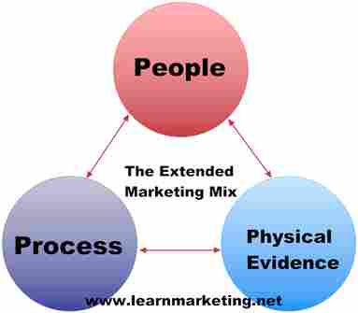
Extended Marketing Mix

Slide 53
Booms & Bitner
Booms and Bitner included three additional 'Ps' to accommodate trends towards a service or knowledge based economy:
People – all people who directly or indirectly influence the perceived value of the product or service, including knowledge workers, employees, management and consumers.
Process – procedures, mechanisms and flow of activities which lead to an exchange of value.
Physical evidence – the direct sensory experience of a product or service that allows a customer to measure whether he or she has received value. Examples might include the way a customer is treated by a staff member, or the length of time a customer has to wait, or a cover letter from an insurance company, or the environment in which a product or service is delivered

Slide 54
7Ps & 7Cs
The 7 Ps |  | The 7 Cs
Organisation Facing |  | Customer Facing
Product | = | Customer/ Consumer
Price | = | Cost
Place | = | Convenience
Promotion | = | Communication
People | = | Caring
Processes | = | Co-ordinated
Physical Evidence | = | Confirmation

Slide 55
Fundamental Actions
The term 'marketing mix' however, does not imply that the 4P elements represent options.
They are not trade-offs but are fundamental marketing issues that always need to be addressed.
They are the fundamental actions that marketing requires whether determined explicitly or by default.

Slide 56
Product
Variety
Quality
Design
Features
Brand Name
Packaging
Service

Slide 57
Product Variety
Even today, manufacturers of products which are built to customer order, for example, cars, airplanes and medical equipment, offer such a large range of combinations of product features that millions of variants of a single product are possible.
Commercially available software systems support the automation of many aspects of the engineering process; product databases enable the description of single products and engineering applications can use these product descriptions to carry out their tasks.

Slide 58
Product Quality
A product or process that is reliable, and that performs its intended function is said to be a quality product.
Quality in business, has an interpretation as the non-inferiority or superiority of something.
Quality is a perceptual, conditional and somewhat subjective attribute and may be understood differently by different people.
Consumers may focus on the specification quality of a product/service, or how it compares to competitors in the marketplace.

Slide 59
Product design
Product design can be defined as the idea generation, concept development, testing and manufacturing or implementation of a physical object or service

Slide 60
Brand Name
The brand name is often used interchangeably within "brand", although it is more correctly used to specifically denote written or spoken linguistic elements of any product.
In this context a "brand name" constitutes a type of trademark, if the brand name exclusively identifies the brand owner as the commercial source of products or services

Slide 61
Product
Instruments that aim at satisfaction of the prospective exchange party’s needs
Examples: Product characteristics, options, assortments, packaging, guarantees, quality, features, style, brand name, size & packaging, services, warranties/guarantees, returns & replacements

Slide 62
Place
Place represents the location where a product can be purchased.
It is often referred to as the distribution channel. It can include any physical store as well as virtual stores on the Internet.

Slide 63
Place
Physical distribution are activities involved in transporting products from the producer to the consumer:
Mode of transport
Warehousing & Storage
Order processing
Inventory control

Slide 64
Place
Channels of distribution are the routes through which the ownership of goods flow on its way from the producer to the customer
Distributor
Wholesalers
Retailers

Slide 65
Place
Instruments that determine the intensity & manner in which goods or services will be made available
Types of channels, density of distribution, trade-relation mix, merchandising advise

Slide 66
Place
Channels
Coverage
Locations
Inventory
Transportation
Logistics

Slide 67
Price
The price is the amount a customer pays for the product.
It is determined by a number of factors including market share, competition, material costs, product identity and the customer's perceived value of the product.
The business may increase or decrease the price of product if other stores have the same product.

Slide 68
Price
List Price
Discounts
Allowances
Payment Period
Credit Terms

Slide 69
List Price
In retail, price regularly quoted to customers before applying discounts. List prices are usually the prices printed on dealer lists, invoices, price tags, catalogs, or dealer purchase orders.

Slide 70
Discounts & Allowances
Discounting is a financial mechanism in which a debtor obtains the right to delay payments to a creditor, for a defined period of time, in exchange for a charge or fee
Discounts and allowances are reductions to a basic price of goods or services.

Slide 71
Payment Period & Credit Terms
The stipulation by a business as to when it should be paid for goods or services supplied, for example, cash with order, payment on delivery, or within a particular number of days of the invoice date

Slide 72
Price
Price is the amount a consumer pays in exchange for the product or service.
Marketers must consider the following in setting prices:

Slide 73
Price
Target segment- How much the target segment is willing to pay at different price levels- price elasticity of demand
Cost- How much it costs the firm to produce & market the product
Competition- Prices of competitors
Society & Law- Within legal framework

Slide 74
Price
Marketers have to determine prices to consumers & channel partners
Prices across models & geographic regions have to be established
Policies on discounts have to be framed
These decisions are vital to enhance sales volumes

Slide 75
Innovative Discounts
Discount sales in shopping malls
Off season sales
Closing down sales
Festival sales
Credit points
Exchange offers – mobiles, cookers, cars

Slide 76
Promotion
Promotion activities are meant to communicate & persuade the target market to buy the company’s products
This is done by:-

Slide 77
Promotion
Advertising
Personal selling
Sales promotion- POS
Public Relations
Word of mouth – Viral advertising

Slide 78
Promotion
Promotion represents all of the communications that a marketer may use in the marketplace.
Promotion has five distinct elements – advertising, personal selling, public relations, word of mouth and point of sale.
A certain amount of crossover occurs when promotion uses the five principal elements together
Advertising covers any communication that is paid for, from and cinema commercials, radio and Internet adverts through print media and billboards.

Slide 79
Personal selling
Personal Selling: Face to face personal communication- Eureka Forbes
In person selling, tele-marketing
Advertising- Mass communication efforts through media
Sales Promotion- Communication through contests, OOH, trade shows, free samples, yellow pages, call helplines

Slide 80
Publicity
Publicity- Communicating with an audience by personal or non-personal media that are not paid for delivering the message

Slide 81
Public Relations
Public relations are where the communication is not directly paid for and includes press releases, sponsorship deals, exhibitions, conferences, seminars or trade fairs and events.
Word of mouth is any apparently informal communication about the product by ordinary individuals, satisfied customers or people specifically engaged to create word of mouth momentum.

Slide 82

Public Relations
Press Conferences

Slide 83
Word of mouth publicity
Word of mouth is a reference to the passing of information from person to person. Originally the term referred specifically to oral communication but now includes any type of human communication, such as face to face, telephone, email, and text messaging

Slide 84
Viral Marketing- Word of mouth
Viral marketing depends on a high pass-along rate from person to person.
If a large percentage of recipients forward something to a large number of friends, the overall growth snowballs very quickly.
If the pass-along numbers get too low, the overall growth quickly fizzles.

Slide 85
On the internet
On the Internet, viral marketing is any marketing technique that induces Web sites or users to pass on a marketing message to other sites or users, creating a potentially exponential growth in the message's visibility and effect.

Slide 86
Definition- Viral Marketing
The buzzwords viral marketing and viral advertising refer to marketing techniques that use pre-existing social networks to produce increases in brand awareness or to achieve other marketing objectives (such as product sales) through self-replicating viral processes, analogous to the spread of pathological and computer viruses.
It can be word-of-mouth delivered or enhanced by the network effects of the Internet.
Viral promotions may take the form of video clips, interactive Flash games, advergames, ebooks, brand able software, images, or even text messages.
The basic form of viral marketing is not infinitely sustainable.

